Slide 1


Our Vision,
Mission, Values, & Goals
An Overview of the 2012-2013
Comprehensive Strategic Review Plan

Slide 2

What?
Comprehensive Review
of our Vision, Mission, Values, and Goals

Slide 3
Key Elements
Vision
What we aspire to be in the future
Mission
Our purpose
Goals
Broad long-term outcomes
Values
Shared principles and beliefs that guide our behaviors

Slide 4

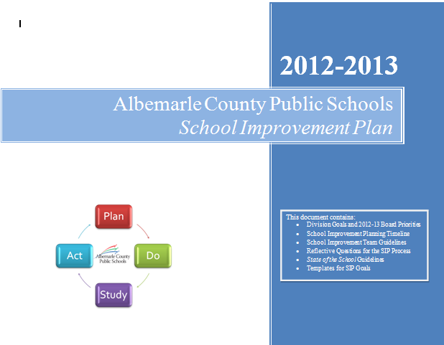
Why does this matter?
FOCUS: The Strategic Plan guides our work and key decision-making including the budget process and school improvement planning

Slide 5

Why Now?
2005 – Original Vision, Mission, Goals Adopted
2009 – Limited Focus Group Review
2012 – Time to Initiate a Comprehensive Review

Slide 6


How?
Two Frameworks:
Stakeholder-Driven Strategic Planning in Education (Ewy, 2009)
Baldrige Education Criteria for Performance Excellence

Slide 7
Envision
What would students be doing?
What would teachers be doing?
What would administrators be doing?
What would support staff be doing?
Picture the IDEAL STATE
for our schools in the future. If we achieved everything we hoped:

Slide 8
In our current plan…
What should carry forward?
What should be removed?
What should be modified?
What should be added?

Slide 9
Essential Questions
1. What are the greatest challenges and issues our division has to address now and in the future in order to provide the highest quality education to all students?
2. What are the most important competencies all students need to know or be able to do to be prepared for a successful future?
3. What are the most important competencies all teachers need to know or be able to do to prepare all students for a successful future?
4. What evidence do we collectively use to evaluate the quality of education in our school division?
5. What should the overall priorities be for our school division over the next five years?
6. What could the school division do that would inspire parents, students, and the community?
Source: Adapted from Ewy

Slide 10
When?
Sept - Oct
Raise Awareness
Nov – March
Gather & Analyze Information from Stakeholders
April – June
Synthesize & Report

Slide 11
Three Phases
Phase 1: Raise Awareness
September - October
SAB
Phase 2: Gather & Analyze Feedback from Stakeholders
November – March
K12 Insight Open Feedback Survey
Phase 3: Synthesize Feedback & Present to School Board
April - June
Quality Council Summary of Findings Presented to Cabinet
Compass
BbConnect
Web Site
Press Release
Notification to Advisory Group Leads
Advisory Group Visits
Focus Group Visits
Feeder Pattern Town Hall Meetings
Environmental Scan and Resource Review
Social Media
Final Report Presented to School Board prior to Retreat
Analysis of Feedback

Slide 12
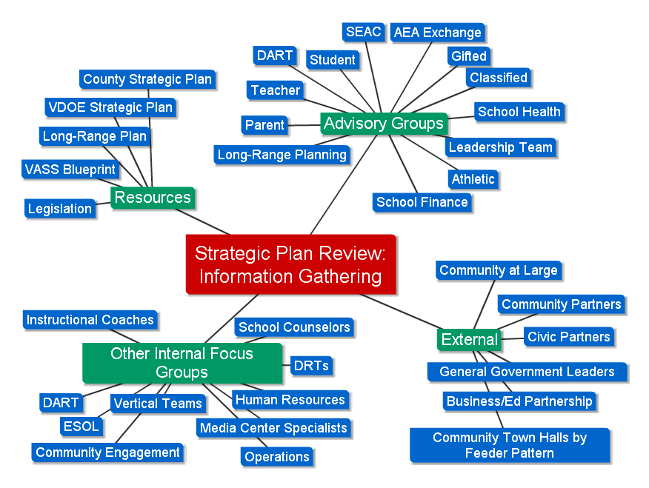
Reaching our stakeholders

Slide 13
Raise Awareness
Internal announcements in SAB and Compass
Media release
Web site and social media
Contacts through Office of Community Engagement
BbConnect call
Announcement sent to advisory group contacts
Announcement at internal meetings
English and Spanish

Slide 14
Information Gathering
Visits to existing ACPS meetings
(ex. Advisory Groups, Departments)
Feedback form open to all stakeholders including Community at Large
Town hall meetings by feeder pattern
Outreach to community and civic organizations
Targeted Board
work session
Review of current legislation, national trends, key research
Review of County strategic plan
Review of State Board of Education strategic plan
Review of VASS Blueprint

Slide 15
Synthesis & Reporting
Stakeholder Input and Analysis
Synthesis by Quality Council
Report to Superintendent and Cabinet
Report to School Board

Slide 16
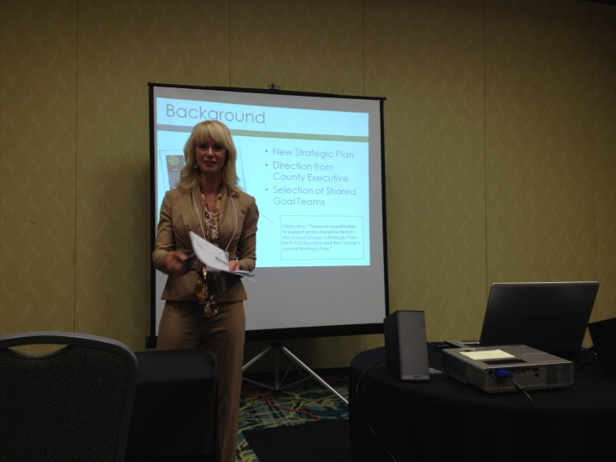
For More Information or to Review the Current Strategic Plan
http://www.k12albemarle.org/strategicplanning
Melissa Anderson presenting with Louise Wyatt at the Virginia SPQA Forum for Excellence on Tuesday, September 11, 2012.

